Slide 1
Driver Monitoring System for Attention Detection
Mehak Saleem
Laiba Barg
Mingxuan Yan
University of California, Riverside

Slide 2
Research Problem & Motivation
Driver Inattention and Road Accidents
Focus on Drowsiness Detection
Limitations of Existing Monitoring Systems
Source: NHTSA and Triple-I

Slide 3
Proposed Approach - CNN based Technique
Deep Learning for Feature Extraction
Improved Robustness
Scalability & Adaptability
Reduction in False Alarms

Slide 4
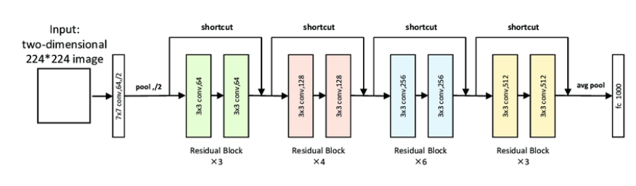
ResNet34 - Deep Residual Networks
Provides Balanced depth (34 layers)
Lower computational cost than deeper variants like ResNet50/101.
Source: Y. Wang, L. Zhang, and X. Liu, "A Multi-Dimensional Covert Transaction Recognition Scheme for Blockchain," ResearchGate, 2023.

Slide 5
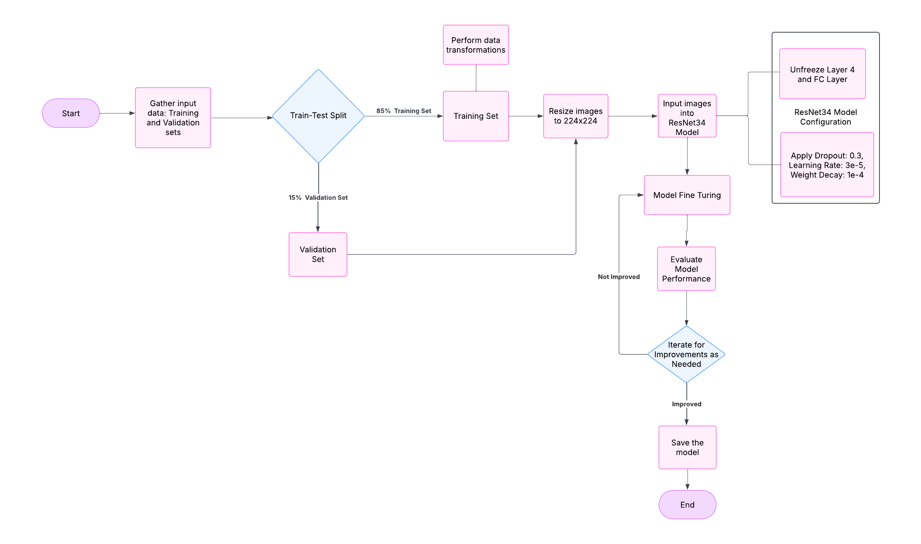
Proposed Methodology

Slide 6
Data Collection & Preprocessing
Main Dataset: (Real-Time Driver’s Drowsiness Monitoring Based on Dynamically Varying threshold)
3 subjects → (Neutral, Eyeclose, Yawn)
1208 correctly labeled images of driver states.
Additional Dataset:
YawDD (for yawn samples)
Closed Eyes in the Wild (CEW) dataset (for eye closed sample)
Labeled Face in the Wild dataset ( neutral samples)
Preprocessing Steps
Normalization and resizing
Data augmentation (flipping, brightness adjustment, random crop, random rotation).

Slide 7
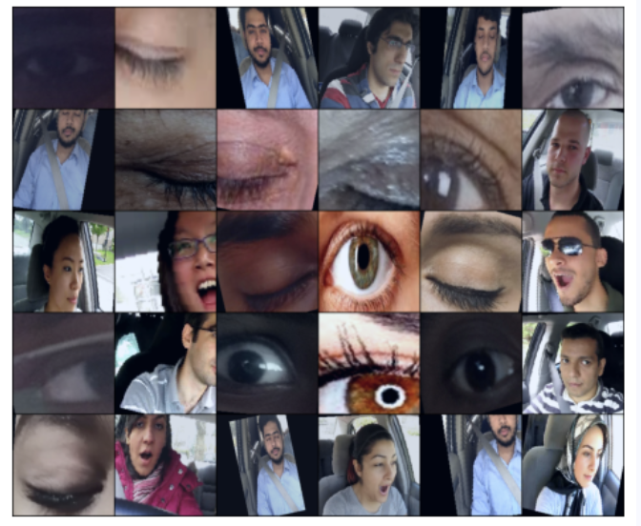
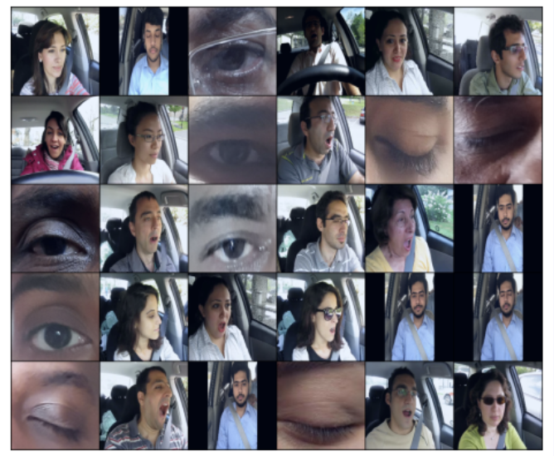
Train & Validation Set
Train Set (3242 Images)
Validation Set (573)

Slide 8
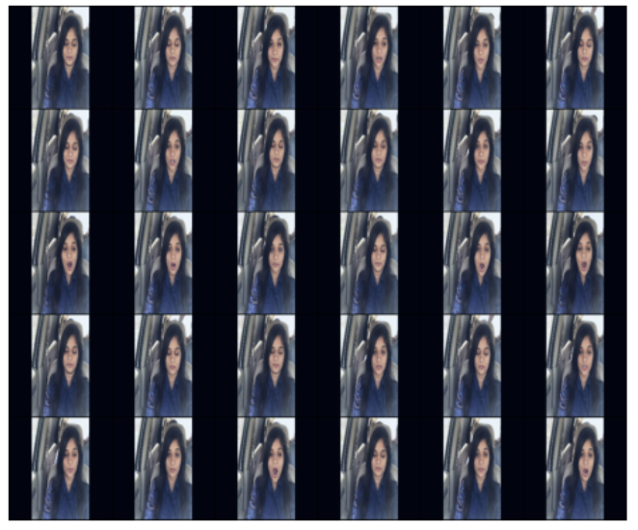
Test Set
Test Set: Subj3 in test set (293 Images)

Slide 9
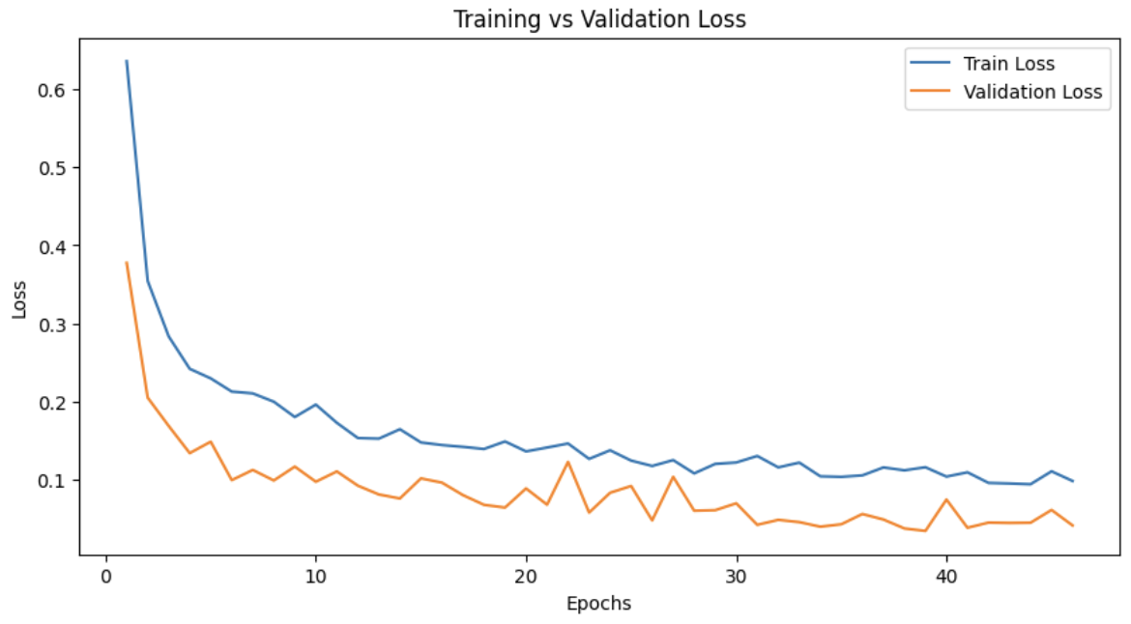
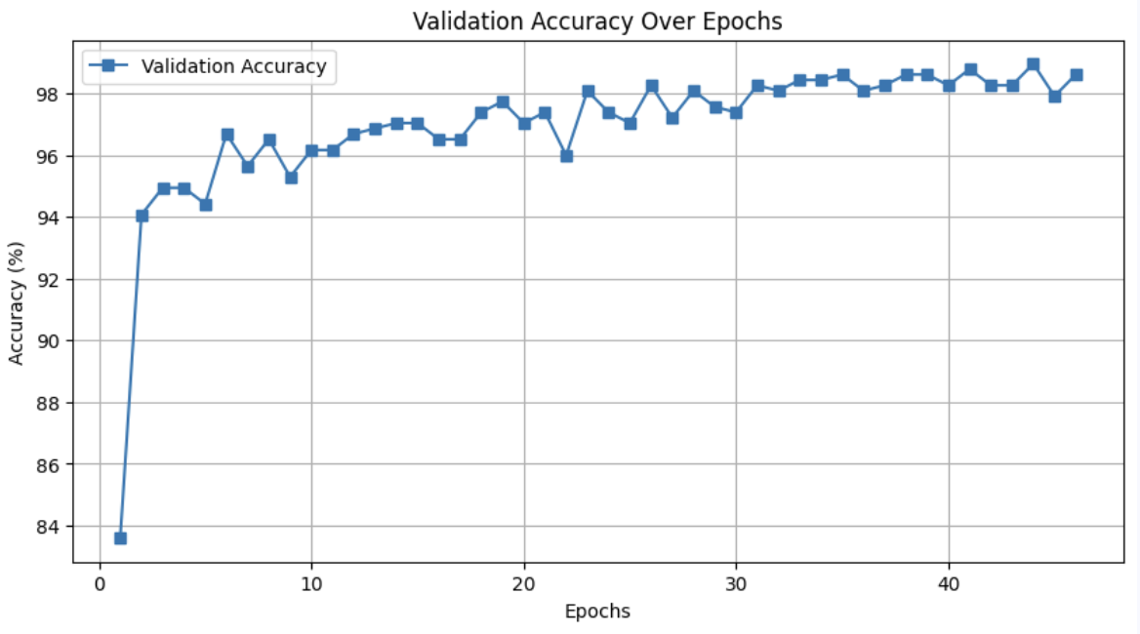
Results
Layer 4 and FC Unfreezed with dropout 0.3
LR: 3e-5
Weight Decay: 1e-4
Training vs Validation Loss
Validation Accuracy

Slide 10
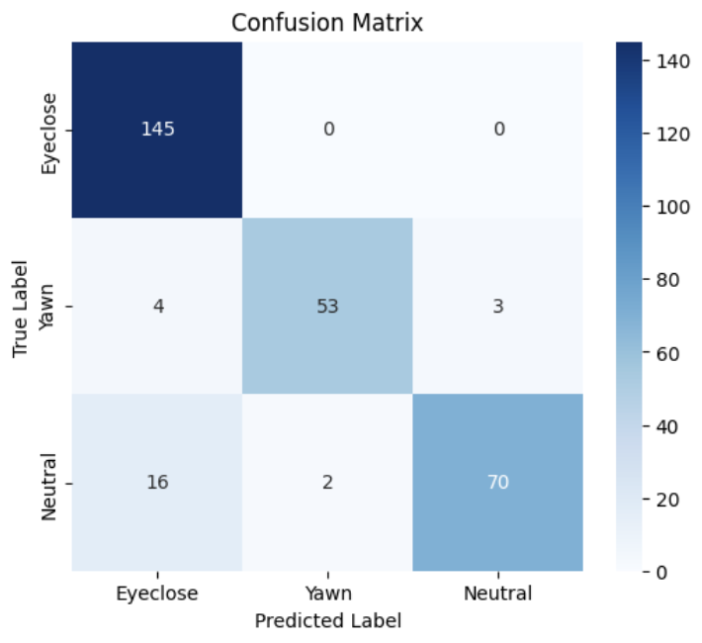
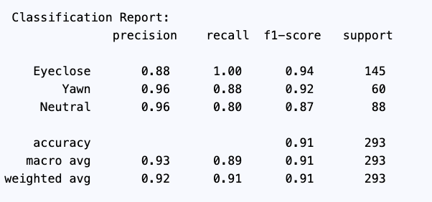
Results
Test Accuracy: 91.47%

Slide 11
References
[1] M. J. Kang and W. Y. Chung, "EYE GAZE TRACKING BASED DRIVER MONITORING SYSTEM," IEEE Xplore, 2018. [Online]. Available: https://ieeexplore.ieee.org/abstract/document/8326022.
[2] B. T. Jap, S. Lal, P. Fischer, and E. Bekiaris, "Affordable Visual Driver Monitoring System for Fatigue and Monotony," IEEE Xplore, 2005. [Online]. Available: https://ieeexplore.ieee.org/document/1401415.
[3] C. P. Hu, T. Liu, and J. Zhao, "Deep Learning Based Real-Time Driver Emotion Monitoring," IEEE Xplore, 2018. [Online]. Available: https://ieeexplore.ieee.org/document/8519595.
[4] R. Patel, A. Kumar, and D. S. Brown, "Smart Driver Monitoring Robotic System to Enhance Road Safety: A Comprehensive Review," arXiv preprint, 2024. [Online]. Available: https://arxiv.org/pdf/2401.15762.
[5] Y. Wang, L. Zhang, and X. Liu, "A Multi-Dimensional Covert Transaction Recognition Scheme for Blockchain," ResearchGate, 2023. [Online]. Available: https://www.researchgate.net/publication/368590488_A_MultiDimensional_Covert_Transaction_Recognition_Scheme_for_Blockchain.

